Slide 1


CY378 · SIMULATION AND MODELING
Agent-Based Simulation and Redesign of the
Terbrebie Junction Road Network
A Traffic and Pedestrian Flow Improvement Study Using AnyLogic
Presented to: Frank Laude Boateng
Group Project · Group Leaders: Adu Paul & Donkor Zipporah
26 July 2026

Slide 2
Group Members
CY378 - Simulation and Modeling
No. | Name | Index Number
1 | Adu Paul | FCM.41.018.014.23
2 | Boateng Yaw Opoku | FCM.41.018.107.23
3 | Felix Agyire | FCM.41.018.023.23
4 | Donkor Zipporah | FCM.41.018.126.23
5 | Enoch Oduro | FCM.41.018.197.23
6 | Joseph Eduafo | FCM.41.018.128.23
7 | Nakorei Abdulai Shafiyu | FCM.41.018.180.23
No. | Name | Index Number
8 | Mensah-Onumah Jonathan Jnr. | FCM.41.018.174.23
9 | Coffie Obed Kakari | FCM.41.018.115.23
10 | Dick Bismark Kojo | FCM.41.018.123.23
11 | Nouterah Maxwell Fagbom | FCM.41.018.187.23
12 | Biney Justice | FCM.41.018.097.23
13 | Amoo Samuel Nii Dodoo Obrempong | FCM.41.018.052.23
14 | Adelaide Ntriwaa Boakye | FCM.41.018.100.23
Terbrebie Junction - CY378 Simulation and Modeling
1

Slide 3

Background of the Study Area
Terbrebie Junction is a busy intersection connecting a main arterial road with a secondary access road, surrounded by residential houses, shops, and commercial buildings.
4
Approach Roads Modelled
It is used daily by private cars, commercial vehicles, heavy trucks, and pedestrians, with visible peaks during the morning and evening commute.
6
Pedestrian Crossing Points
This project applies agent-based and road traffic modelling concepts from CY378 to study the junction, identify weaknesses in its current design, and simulate a redesign for improved safety and efficiency.
3
Signalised Traffic Lights
Terbrebie Junction - CY378 Simulation and Modeling
2

Slide 4
The Problem: Condition of the Existing Road
1
Single Lanes Only
2
No Traffic Light Control
Every approach had just one lane per direction, so any slow, turning, or broken-down vehicle blocked all traffic behind it.
Right of way was negotiated informally between drivers, causing congestion, confusion, and frequent near-miss incidents.
3
No Pedestrian Crossings
4
Poor Road Surface
No zebra crossings existed despite heavy foot traffic, forcing pedestrians to cross wherever they judged it safe.
Uneven, poorly paved roads slowed traffic further and made the junction less safe and comfortable overall.
Terbrebie Junction - CY378 Simulation and Modeling
3

Slide 5
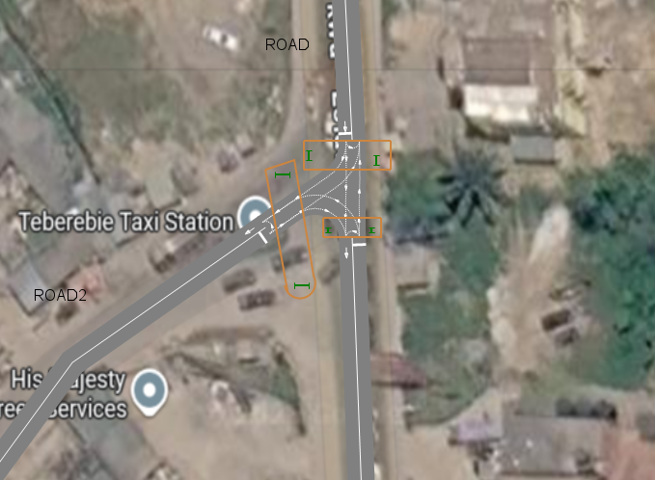
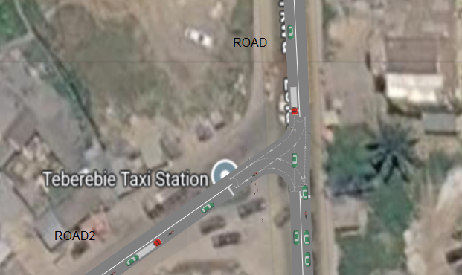
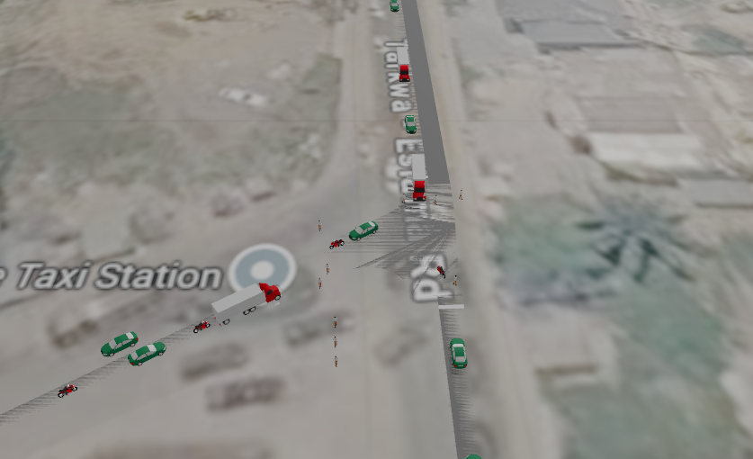
Site Evidence: The Junction Before Redesign
Photographs and site analysis confirming the deficiencies of the original layout
Aerial view of the original junction: single-lane approaches, no traffic light.
Close-up view confirming the absence of lane markings and pedestrian crossings.
Site analysis marking locations identified for new traffic lights and crossings.
Terbrebie Junction - CY378 Simulation and Modeling
4

Slide 6
Objectives of the Project
1
Recreate the existing single-lane, unsignalised layout as a baseline model in AnyLogic
2
Design and implement double lanes, signalised control, and marked pedestrian crossings
3
Model vehicle and pedestrian interaction using the Road Traffic and Pedestrian Libraries
4
Evaluate, through simulation, whether the redesign reduces congestion and improves safety
5
Present findings and recommendations suitable for academic and practical use
Terbrebie Junction - CY378 Simulation and Modeling
5

Slide 7
Methodology and Tools Used
AnyLogic Simulation Software
Road Traffic Library
carSource, selectOutput, carMoveTo, carDispose, and traffic light objects
A multi-method simulation platform providing purpose-built libraries for road traffic and pedestrian dynamics, allowing vehicles and pedestrians to be modelled as individual interacting agents.
Pedestrian Library
pedSource, pedGoTo, pedWait, and pedSink objects
2D / 3D Scene Design
Project file: TerbrebieJunction3.alp
Lane markings, buildings, and surroundings modelled to resemble the real junction
Terbrebie Junction - CY378 Simulation and Modeling
6

Slide 8
The Redesign at a Glance
Four changes address every weakness of the original junction
Double Lanes
Traffic Lights
Zebra Crossings
Resurfacing
Replaces every single lane with two, increasing capacity and separating through and turning traffic.
Introduces signal control, formally assigning right of way and coordinating vehicle and pedestrian phases.
Marks safe, predictable pedestrian crossing points tied to the signal cycle.
Replaces the deteriorated surface with a well-paved, clearly marked road.
Terbrebie Junction - CY378 Simulation and Modeling
7

Slide 9
Why Double Lanes Were Added
Additional capacity allows more vehicles to be processed within the same time, reducing queue lengths at peak periods
Slower vehicles, such as turning or loading trucks, no longer block the entire flow of traffic
Separate lanes allow through-traffic and turning traffic to be assigned to specific lanes, reducing conflict points
Extra manoeuvring space improves overall safety when drivers must react to unexpected situations
Terbrebie Junction - CY378 Simulation and Modeling
8

Slide 10
Why Traffic Lights Were Installed
Formally assign right of way, removing the informal negotiation that caused delays and near-collisions
Coordinate vehicle movement with pedestrian crossing phases so rights of way never conflict
Can be tuned to match real demand on each approach, optimising the flow of traffic
Create a predictable stop-and-move pattern, reducing sudden braking and gridlock
Terbrebie Junction - CY378 Simulation and Modeling
9

Slide 11
Why Zebra Crossings Were Introduced
Give pedestrians a clearly marked, predictable place to cross, rather than crossing at random points
Paired with the pedestrian signal phase, ensure a protected interval to cross safely
Reflect the residential character of the area and the meaningful volume of daily foot traffic
Reduce informal, unpredictable crossing behaviour and lower the risk of pedestrian accidents
Terbrebie Junction - CY378 Simulation and Modeling
10

Slide 12
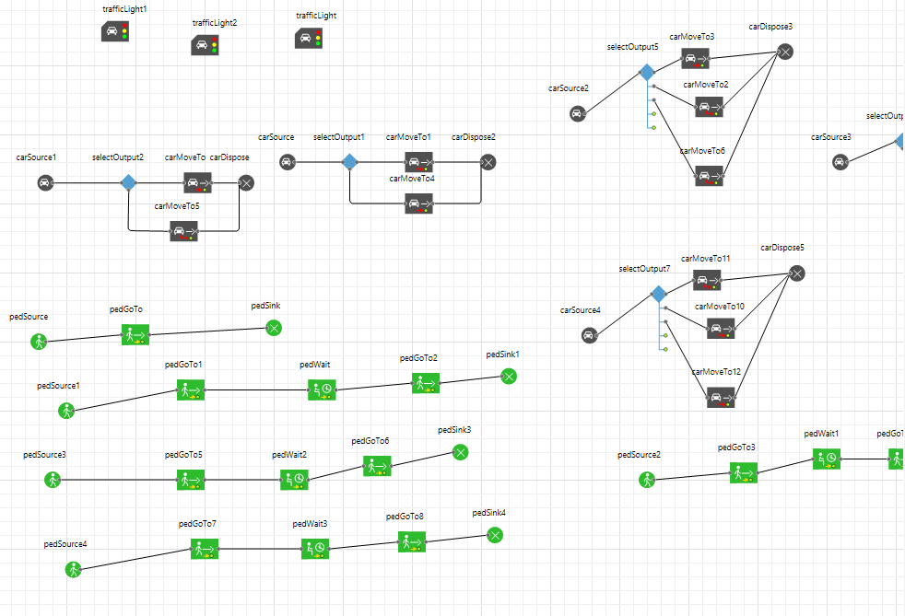
Model Architecture
How vehicle and pedestrian agents flow through the model
Component | Function
carSource / pedSource | Generate vehicles and pedestrians at each approach into the junction
selectOutput | Routes each vehicle onto the correct lane or path
carMoveTo / pedGoTo | Moves agents along a defined lane, path, or crossing
Traffic Light | Coordinates right of way between vehicle and pedestrian flows
pedWait | Holds pedestrians at the kerb until the crossing phase is granted
carDispose / pedSink | Removes agents from the model once their journey is complete
Figure: Process flow of car and pedestrian agents
Terbrebie Junction - CY378 Simulation and Modeling
11

Slide 13
Model Verification and Validation
Confirming the model was built correctly, and that it credibly represents the real junction
Verification - “Building the Model Right”
Validation - “Building the Right Model”
• Stepped through the model at reduced speed to trace vehicles and pedestrians through every block
• Cross-checked the process flow diagram against the actual AnyLogic model, block by block
• Confirmed every generated agent was eventually removed at its dispose or sink block, with none lost or stuck
• Checked that selectOutput routing probabilities sent vehicles onto the correct lanes as intended
• Verified traffic light phase timings matched configured values, with no conflicting phases active together
• Face validation: compared the AnyLogic 2D/3D layout against real satellite images and site photographs
• Group members familiar with the junction confirmed the simulated congestion and pedestrian patterns were realistic
• Extreme condition tests: very low and very high arrival rates produced logically consistent free flow and queuing
• Sensitivity checks: adjusting signal phase durations changed queue lengths and waits in the expected direction
• Full validation remains partial until the redesign is built and compared against real traffic data
Terbrebie Junction - CY378 Simulation and Modeling
12

Slide 14
Economic Implications
Capital & Operational Expenditure (Infrastructure Costs)
Travel Time & Congestion Savings
Accident Cost Reduction
Economic Development & Land-Use Secondary Effects
Upfront capital costs must be met by local government or road authorities, but these costs are typical amortized over a 15 to 20-year design life, keeping annual costs modest relative to overall construction figures.
The most immediate and directly quantifiable benefit is the reduction in vehicle delay
Road accidents impose high monetary costs on households, emergency services, healthcare facilities, and insurance systems. Safety is improved through three mechanisms.
Reduced congestion and safer walking access boost customer visits to nearby small businesses and informal traders
Terbrebie Junction - CY378 Simulation and Modeling
14

Slide 15
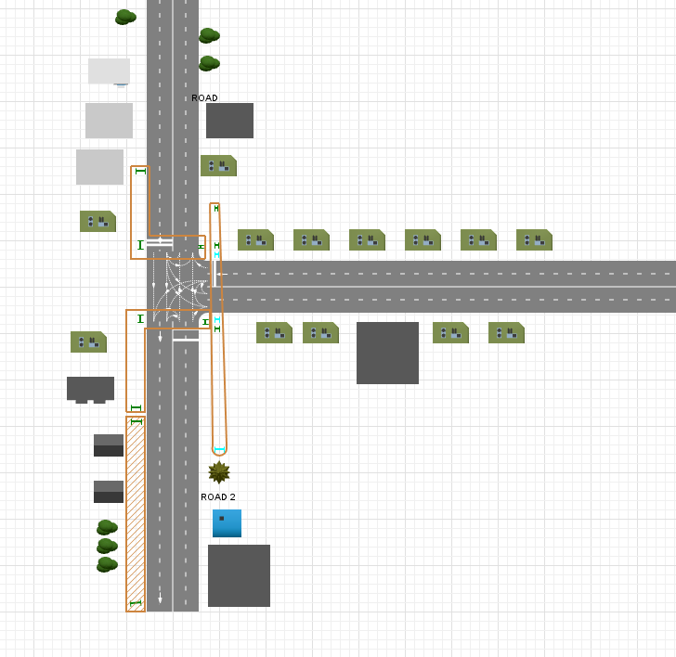
Redesigned Junction - 2D Layout
Double lanes, traffic lights, and marked pedestrian crossings
Terbrebie Junction - CY378 Simulation and Modeling
12

Slide 16
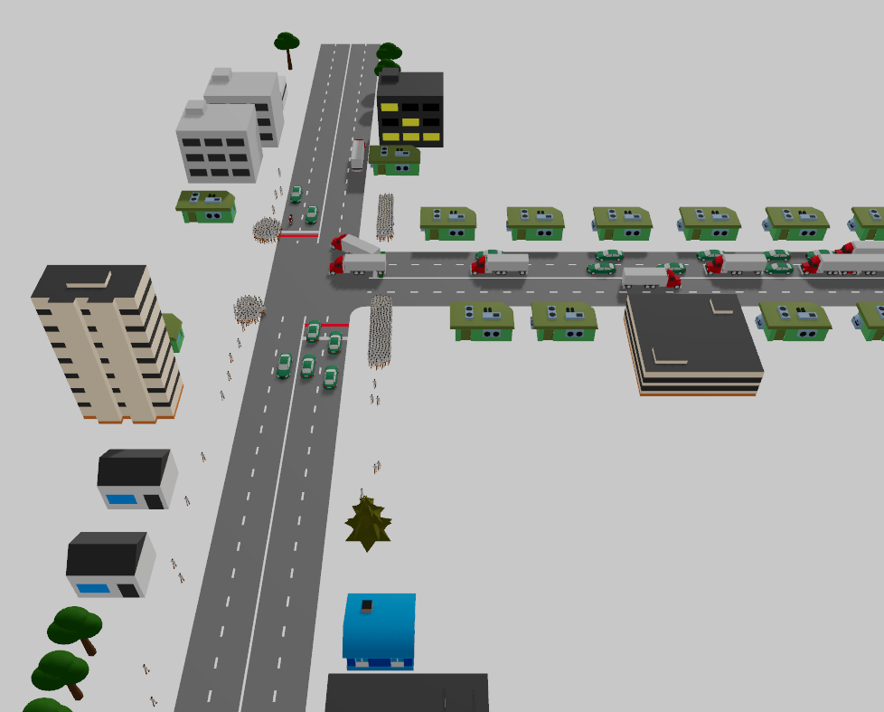
Redesigned Junction - 3D Simulation View
Vehicles and pedestrians moving through the improved layout during a simulation run
Terbrebie Junction - CY378 Simulation and Modeling
13

Slide 17
Expected Outcomes and Benefits
Less Congestion
Orderly Flow
Safer Crossings
Better Experience
Reduced vehicle queuing from added lane capacity and separated turning traffic
Predictable traffic movement from signal control replacing informal right of way
Improved pedestrian safety through crossings coordinated with signal phases
Smoother driving and walking, supported by resurfacing and clear markings
Terbrebie Junction - CY378 Simulation and Modeling
14

Slide 18
Challenges and Limitations
Estimating realistic arrival rates without access to formal traffic count data
Coordinating traffic light timing with pedestrian phases to avoid unrealistic waiting times
Replicating the exact physical geometry of the junction within the simulation environment
Terbrebie Junction - CY378 Simulation and Modeling
15

Slide 19
Conclusion and Recommendations
The simulation demonstrates that the deficiencies of the original Terbrebie Junction, namely single-lane approaches, the absence of signal control, and the absence of pedestrian crossings, can be addressed through double lanes, traffic lights, marked crossings, and improved resurfacing.
The group recommends that the relevant road authority consider these findings for future improvement works, and that real traffic count data be collected beforehand to refine arrival rates and signal timings.
Thank you.
Group Project · CY378 Simulation and Modeling · Lecturer: Frank Laude Boateng

